Slide 1
Module 9 - Metrics
Training Modules for Applying the Mitigation Hierarchy:
Planning Policy and Projects for No Net Loss or a Net Gain of Biodiversity
Module 9
Metrics

Slide 2
Metrics Module – Abstract
This training course is about planning for Biodiversity Net Gain, No Net Loss or a similar conservation outcome. At the very heart of this is the ability to measure losses and gains in biodiversity (qualitatively and quantitatively).
This module covers how loss and gain of biodiversity can be measured.
It introduces the different components of biodiversity to measure and then explains principal aspects of measurement: exchange rules, metrics and accounting systems to do the calculations for offset exchanges (loss and gain).
The module covers basic elements of loss-gain calculations, how to choose a metric or metrics, introduces commonly used ecosystem and species metrics and illustrates how a benchmark with vegetation attributes can be established and applied to measure loss and gain by gauging changes in habitat condition.

Slide 3
Metrics Module - Contents
Contents | Slides
How do you measure loss and gain of biodiversity? Different components of biodiversity to measure | 4-5
Exchange rules and metrics | 6-11
Basic loss-gain calculations | 12-13
Using a benchmark with attributes to measure loss and gain | 14-20
Take home messages | 21

Slide 4
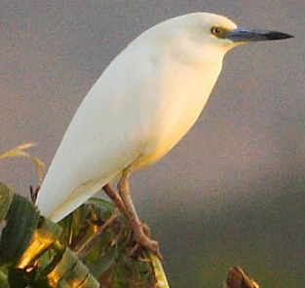
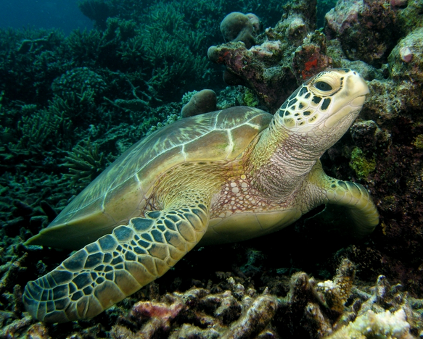
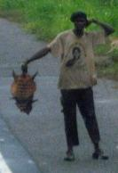
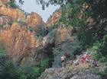
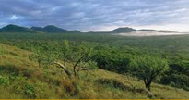
Biodiversity and its different components and values
Biodiversity Component | Intrinsic Values | Use Values | Cultural Values
Species | Threatened species; restricted range and/or endemic species; congregatory species | Species providing fuel, fiber, food, medicines, etc. | Totem species
Habitats/ Communities/ Assemblages | Rare or threatened habitat types; exemplary habitats | Recreational sites | Sacred sites (e.g. sacred groves, burial grounds); sites of aesthetic importance
Whole Landscapes / Ecosystems | Climate regulation; seed dispersal; pollination | Air and water quality regulation; soil fertility; pollination | E.g. Landscape-scale sacred sites
Photo Adam Ridley
→ What to measure and how?
Notes:
According to BBOP, the purpose of a biodiversity offset is to deliver no net loss of all the biodiversity offset components affected by the project. (Note: IFC PS6 differs slightly, focussing particularly for critical habitat on some elements of biodiversity.)
Although the goal of biodiversity offsets is no net loss or a net gain in overall type, amount, and condition of biodiversity, as a practical matter it is impossible to identify and measure the loss and gain of every single biodiversity component affected by a project or conserved through an offset.
A necessary step in evaluating losses and gains is therefore to identify biodiversity components that can be used to represent all biodiversity affected by the project. This subset of components is selected as being characteristic or representative of the biodiversity of the affected area, and/or important for intrinsic as well as use and cultural value, and termed the ‘key biodiversity components’ (KBCs). The KBCs are used in the offset to:
Help identify and evaluate the biodiversity impacts that the development project will have;
Help determine whether impacts can be offset (see Principle 2);
Help identify the offset activities needed to deliver gains to offset residual impacts;
Check that the offset design will deliver specific conservation outcomes;
Establish the ecological equivalence or ‘like for like or better’ comparison of losses and gains;
Inform the selection of the metrics that form the basis of the loss-gain calculation to demonstrate no net loss; and
Provide a basis to check that the offset sites and activities selected can deliver conservation gains for these KBCs, as a proxy for all the biodiversity affected by the project.
The Key Biodiversity Components Matrix illustrated here helps to classify biodiversity components at three levels: species; habitats/biological communities/assemblages; and ecosystems, and also the different values that need to be considered: the intrinsic (existence) values, and also affected people’s socioeconomic use and cultural values.
The offset is intended to address the entirety of biodiversity affected by the development project, but reviewing elements of the offset design against the KBCs, as above, can be a good way to check that this can happen.

Slide 5
Loss and gain of biodiversity:
what to measure and how?
What to measure?
Components of biodiversity… often proxies
Gains
Offsets
Species
Their habitat
Habitat types, Ecosystem types
Ecosystem Processes
Wetland functions
Connectivity
Ecosystem services
Score
0
Score
Residual impacts
How to measure?
→ Appropriate metrics, exchange rules and accounting systems are needed
Losses
See e.g. Quétier F. & Lavorel S. (2011): Assessing ecological equivalence in biodiversity offset schemes: key issues and solutions. Biological Conservation 144, 2991-2999

Slide 6
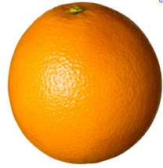
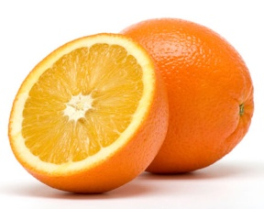
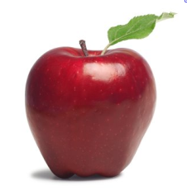
Exchange rules & Metrics
‘Metrics’ or ‘currencies’
‘Exchange rules’
& Net balance
(How much/How many?)
Equivalence/ Like for Like
(What kind?)
→ May need different metrics for different biodiversity components!
Notes:
When it comes to assessing NNL in biodiversity, there really are two aspects to this:
The first is ‘equivalence’ of the residual losses and the gains. Are they of the same in kind or different? This is the ‘what’ part of NNL: We need to establish the KIND OF BIODIVERSITY that is being gained in exchange for the losses. The general starting principle is that offsets need to be ‘like for like’.
In more abstract terms, looking at our cartoon, NNL means that you can not exchange apples for oranges. For example, if a project has an impact on a wetland or mangrove, this would not be offset by conserving rain forest. This is referred to as ‘Exchange rules’.
The other aspect is how a net balance will be achieved in terms of the AMOUNT OF BIODIVERSITY lost and the amount gained. Using our cartoon illustration here, It matters how many oranges are lost and how many oranges gained to claim a net balance. This is referred to as ‘Metrics’. When it comes to biodiversity, given the many different facets of this (species, habitats, ecosystems etc), there are many different ways of measuring the amount lost and gained. And the best measure, or currency, will depend on the biodiversity in question. For ecosystems, what may be often used is the area affected combined with some measure of the quality.

Slide 7
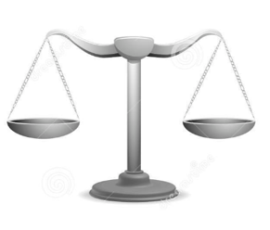
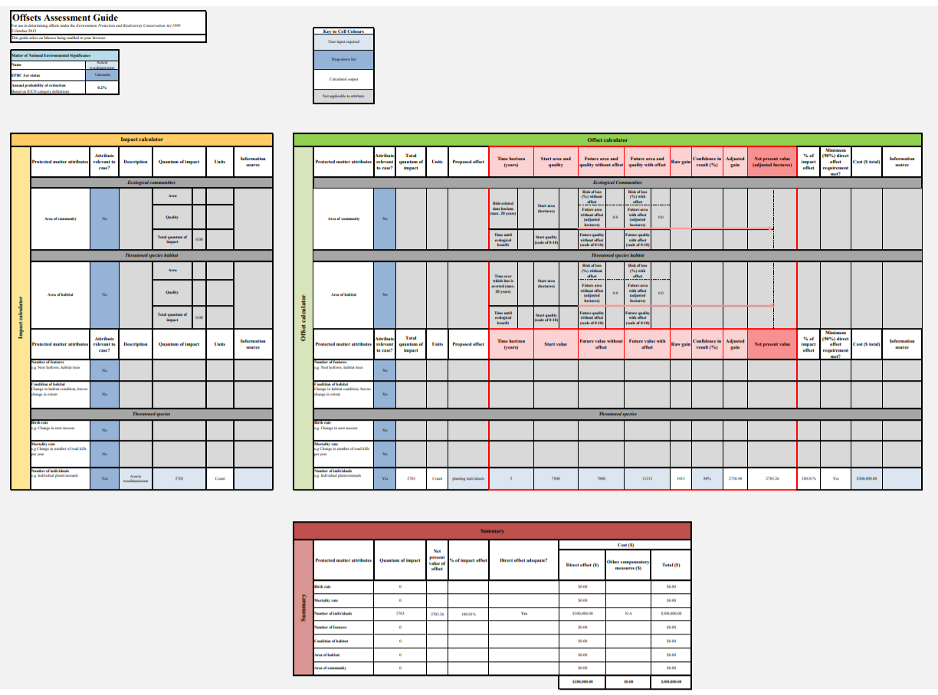
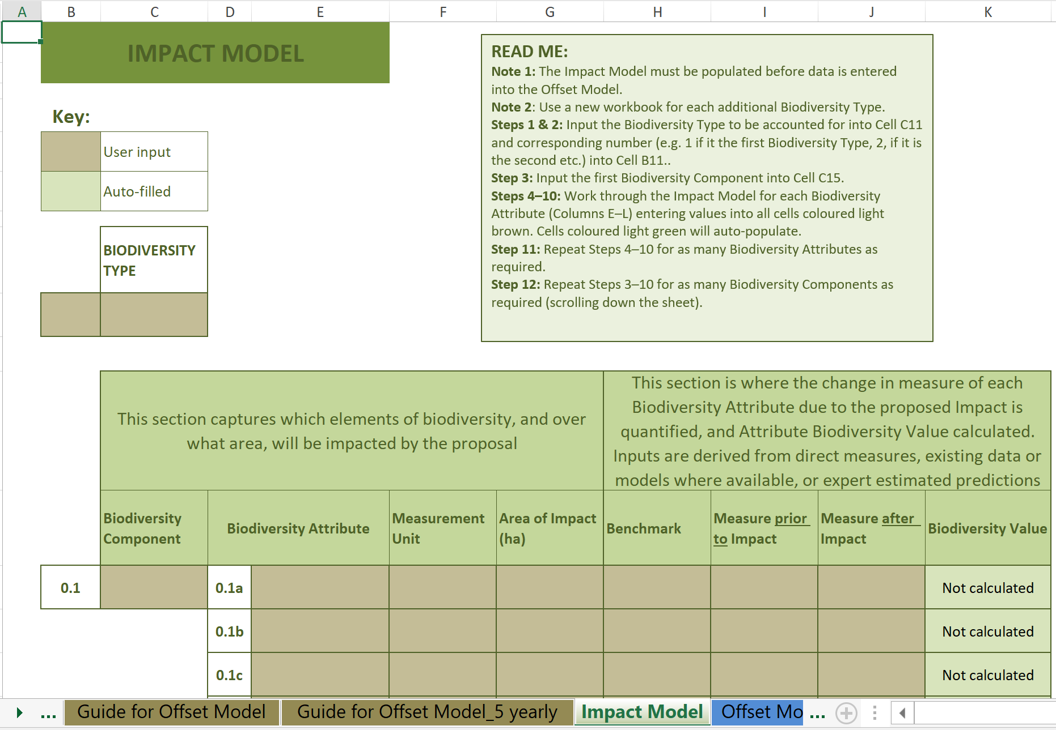
Accounting systems
These are used to combine information (metrics, exchange rules, etc.) and to calculate how much loss of a biodiversity component is expected due to a set of residual impacts and how much gain can be expected from offset actions.
Losses and gains are determined for different biodiversity components / proxies
Losses and gains are calculated in units of the chosen metric for that biodiversity component.
Often integrated in an excel calculator (examples below)
NZ DOC calculator
EPBC calculator
https://www.environment.gov.au/epbc/publications/epbc-act-environmental-offsets-policy
https://www.doc.govt.nz/about-us/our-policies-and-plans/guidance-on-biodiversity-offsetting/biodiversity-offsets-accounting-system/

Slide 8
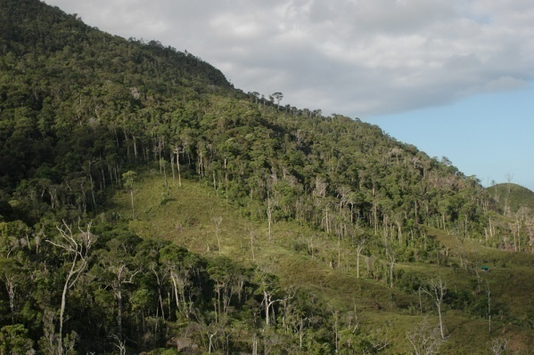
Exchange rules
WHAT KIND of biodiversity is exchanged? Is the loss and the gain ‘equivalent’?
“Like for like (or better)”
(The gains should be of the same type, or of greater conservation concern than the losses caused by residual impacts.)
Roller
with
Roller
Lower montane forest
with
Lower montane forest
→ WHEN do you think it may be appropriate to ‘trade up’
and conserve a different (‘better’) kind of biodiversity to that affected?
Notes:
Briefly returning to the idea of the exchange rules for establishing ‘like for like’, which is one of the two components of measuring NNL:
The central theme is to ensure that the same kind of biodiversity is involved when we are measuring losses and gains.
However, there is also a concept called ‘like for like or better’. The term ‘better’ refers to the possibility of ‘trading up’ – i.e. conserving more important, higher priority biodiversity in return for losses in common/lower priority biodiversity. However, to enable ‘trading up’, you need to decide what the rules for defining ‘better’ are, and whether that’s fair and will genuinely achieve better conservation outcomes than sticking with like for like. Developing exchange rules for trading up requires significant thought, consultation, and data to underpin any decisions made.

Slide 9
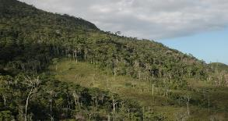
Metrics
What units or index to use measure how MUCH is affected (lost and gained)?
How many birds?
What area (e.g. in ha) of habitat?
➔ Is area alone sufficient to develop an appropriate offset to compensate for impacts?
Notes:
As mentioned earlier, when it comes to biodiversity, there are many different ways of measuring the amount lost and gained. The best metrics, or currency, will depend on the biodiversity in question. For ecosystems what may be often used is the area affected combined with some measure of the quality or condition – i.e. an ‘area x condition’ currency. Area is usually quite easily measured, but there are many different ways of measuring condition appropriately. The kinds of systems available for doing so will vary from country to country and region to region. When it comes to species, there are also different currencies in use – in some instances the habitat of a species (area x condition measure) is used as a proxy for abundance of the species itself. Sometimes population size (proportion affected) or counts of individuals may be used, or breeding pairs. This is the kind of thing that needs to be decided as part of the development of metrics for each NNL system.
Note that there are a few other considerations that are taken into account in the full measure of losses and gains – and this is often called a ‘metric’. A metric will not just take into account the type and amount of biodiversity but also other matters such as the timing of losses and gains, predicted success of offset interventions, and other factors.

Slide 10
There are so many metrics out there! How to choose the right one?
Important to remember:
Metric/s need to be meaningful, i.e. reliably related to the biodiversity component for which loss and gain is being assessed.
Offset actions need to make a difference to the value of the metric, so that a gain can be measured.
Often, more than one metric is needed!
Sometimes one metric can be used for various biodiversity components (e.g. an ecosystem-based metric and calculation can represent other affected biodiversity).
But often a separate metric may be needed to represent e.g. a particular affected species.
NNL/ NG needs to be achieved for each component (and its metric) measured.
Combining different attributes in one metric means a loss in one can be exchanged for a gain in another (e.g. area and condition: e.g. 4 ha x 0.75% = 5 ha x 50%!).
NB – exchange rules can be used to limit this.
The perfect metric may not immediately be available. It may be necessary to start with a very simple metric that can be improved over time.

Slide 11
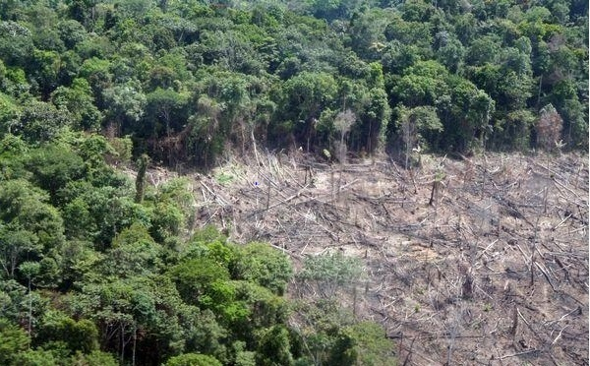
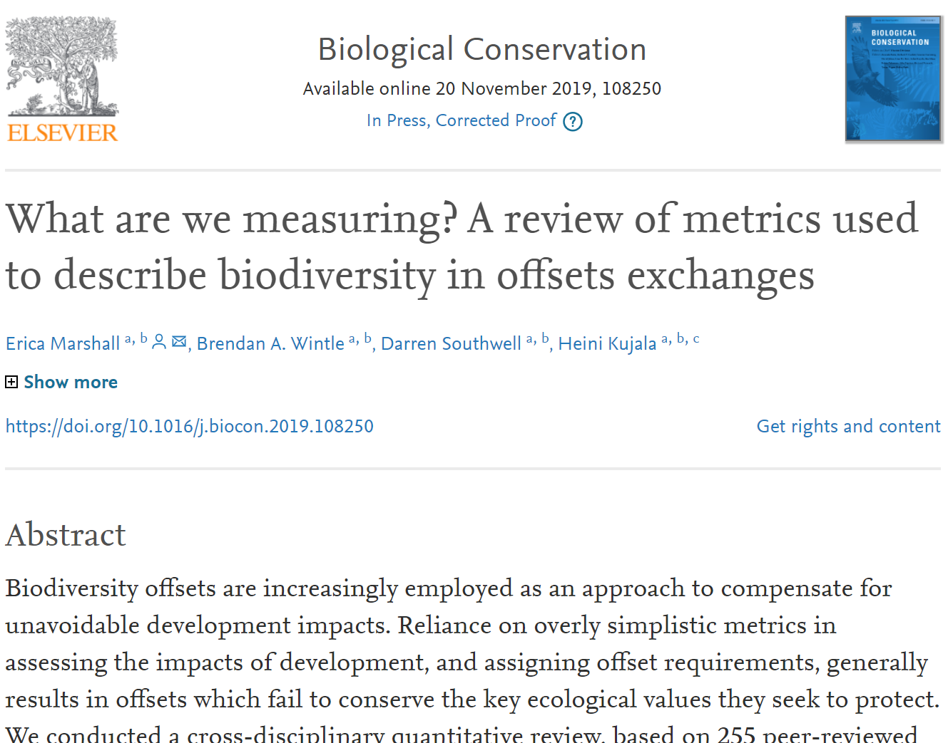
Ecosystem metrics
Most commonly used are condition x area metrics
Area usually not adequate to describe ecosystems as these range from intact to highly degraded → condition is an important factor!
Essential if offset actions include restoration of ecosystem condition
Can be simple or complex
What information is needed?
Classification and mapping of different ecosystem types
Understanding which attributes are most important contributors to ecosystem condition and how they relate to each other
Benchmark values for those attributes in a ‘reference’ or ‘best on offer’ state against which site-based values can be compared.
Measurement of these attributes at site level to work out losses and gains in an offset exchange.
More degraded forest
More intact forest

Slide 12
The aim of a basic ecosystem-based loss-gain calculation
Reliable and precautionary evaluation of predicted impacts is crucial!
Residual impact area x change in condition due to project impacts
needs to be balanced out by
Offset area x change in condition due to offset action
The actual impacts must be evaluated continuously and mitigation adjusted!
Notes:
This is the basic equation for ensuring that an offset’s gains genuinely balance the residual losses, using an area x condition currency. It states that the losses need to be balanced by the gains.
The losses are the change in condition (before and after impact) times the size of the impact.
The gains are the change in condition (before and after the offset activities) times the size of the offset.

Slide 13
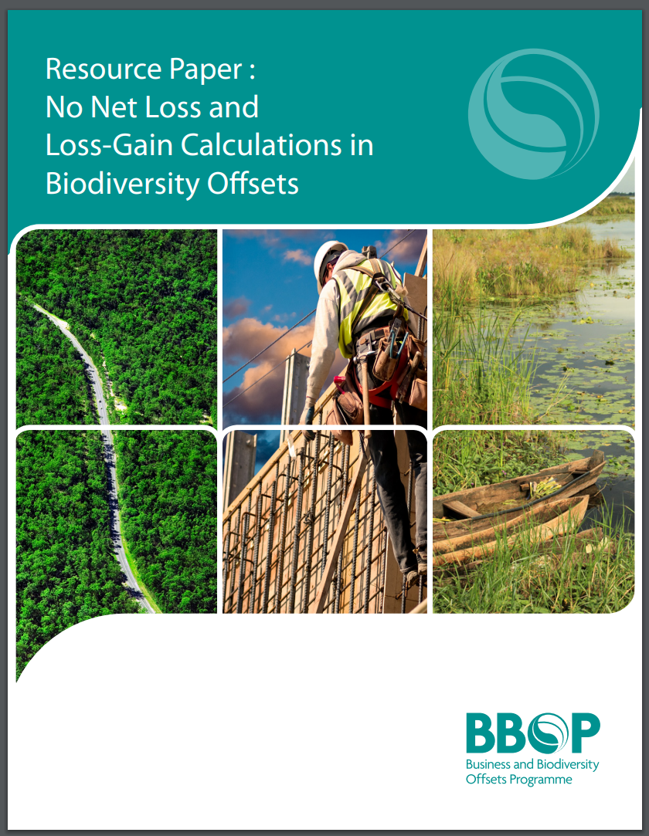
Measuring Area and Condition for Loss-Gain
Area – easy to measure in ha or m2
Condition?
Various ways to describe & measure. Depends on:
biodiversity component in question (e.g. species vs vegetation)
what is meaningful, defensible & commonly used
available data & resources
Ranges from expert judgement to measuring surrogate attributes to direct measures
Benchmarks are often used as a reference of e.g. ‘100%’ (10/10) condition, and values associated with different condition levels are described.
Notes:
NB: What can and cannot be ‘traded’ in loss/gain exchange is a crucial issue (e.g. Need to check different components and how they are represented, condition attributes, also area & condition)

Slide 14
Measuring Quality: habitat score
Assessed against a benchmark for each habitat type

Slide 15
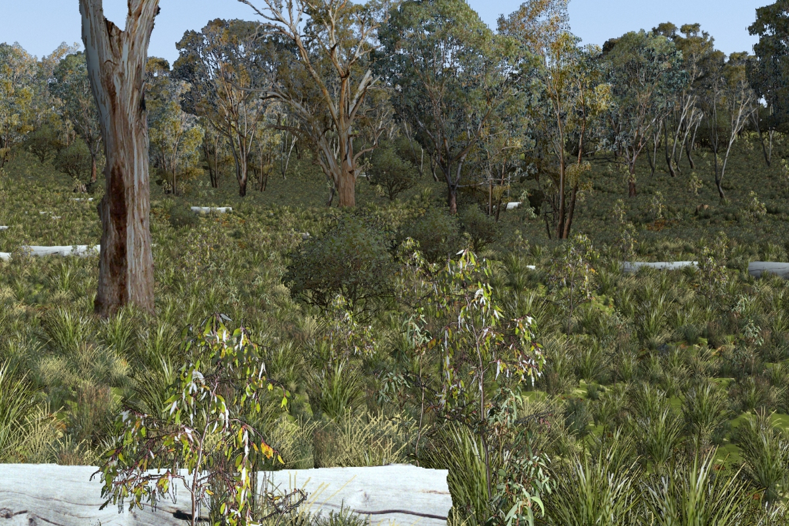
High condition site – attributes measured
size & connectivity of the patch
tree canopy cover
large old trees
understorey diversity
recruitment of young trees
logs & organic litter
Habitat condition score = 9/10
Notes:
.

Slide 16
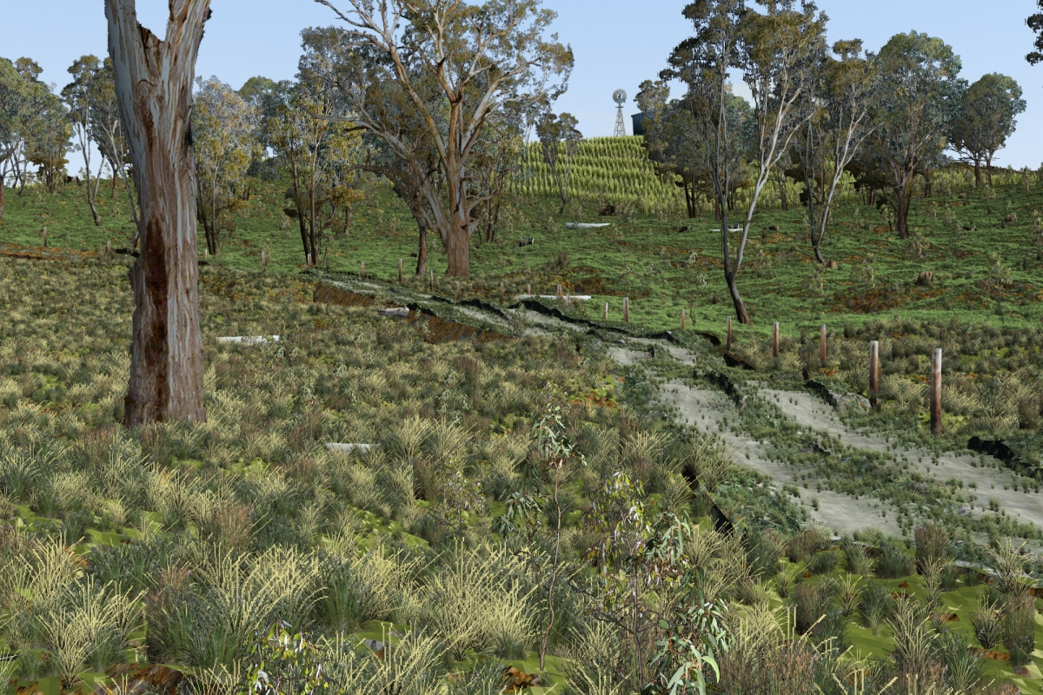
Medium condition site –attributes measured
reduced cover of trees
reduced recruitment
reduced understorey diversity
increased cover of weeds
Habitat score = 5/10

Slide 17
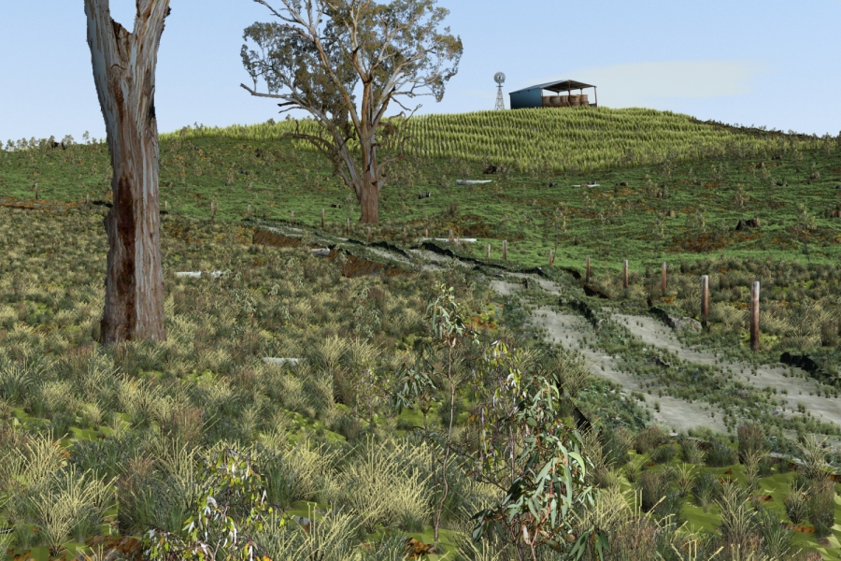
Low condition site –attributes measured
greatly reduced vegetation in landscape
only relict trees
increased cover of weeds
greatly reduced understorey diversity
Habitat score = 2/10

Slide 18
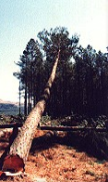
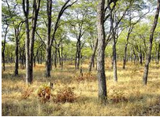
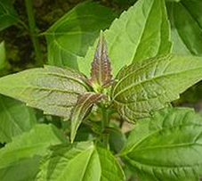
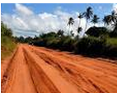
Calculating ecosystem loss and gain: simple example
LOSS
GAIN
1. Project impacts on Miombo woodland:
Area of residual impact: 100 ha
Pre-impact condition: 9/10 relative to ‘potential’ best condition (benchmark or reference level)
2. Offset (restore Miombo woodland, e.g. restore and remove alien spp):
Area of restoration: 500 ha
Pre-impact condition: 4/10
Each hectare:
LOSS: 9/10 GAIN: 5/10
Post-impact condition: 0/10 (no vegetation remains)
Post-restoration condition after 15 years: 9/10
Is this enough to offset residual impacts on Miombo?
This is a NET GAIN!
(but only for Miombo Woodland)
Losses: 100 ha x 0.9 = 90 ‘habitat hectares’
Gains: 500 ha x 0.5 = 250 ‘habitat hectares’

Slide 19
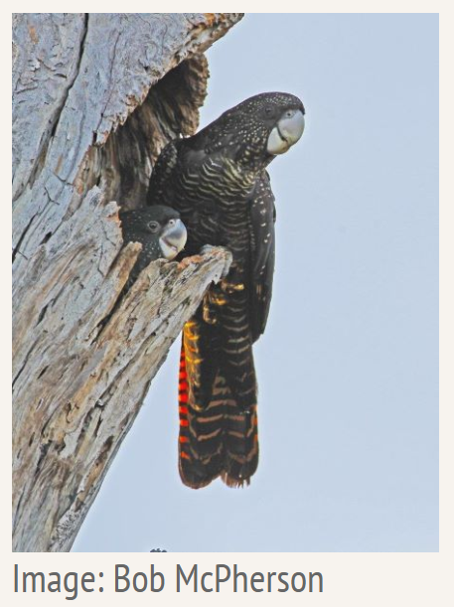
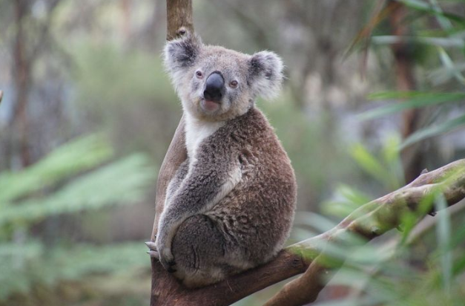
Species metrics
Species metrics often required in addition to ecosystem-based metrics.
→ How to decide what‘s needed?
If the availability of suitable habitat the most important thing for the species, a quality x area habitat metric is appropriate.
If general ecosystem condition is a good surrogate, this can be used.
But often, specific habitat attributes are important for the affected species (e.g. hollows in trees for nesting, etc.) and these must then be included in a tailored metric!
If habitat availability is not the main factor, then direct measures / estimates may be needed. E.g. of:
Individuals/ breeding pairs
Nest sites
Other meaningful surrogates

Slide 20
Metrics through the value chain and investment
⇒ See the module on the Business Roadmap

Slide 21
Metrics Module – Take home messages
Measuring losses and gains in biodiversity (qualitatively and quantitatively) is the heart of determining Biodiversity Net Gain, No Net Loss or a similar conservation goal.
There are different ways of measuring the various components of biodiversity, from species and their habitats to ecosystems and the services they deliver.
Key aspects to balancing losses and gains of biodiversity: metrics, exchange rules and accounting systems:
Exchange rules govern how similar the biodiversity provided by an offset must be to that lost through development. The gains should be of the same type or more important than the losses.
Metrics are the measure used to quantify loss and gain (how much/many) for a biodiversity component
Accounting systems combine information and rules to calculate how much is lost and needs to be gained
An ecosystem metric using area x condition is the principal metric used in most countries. This is often a practical way to measure loss and gain (same units) of biodiversity overall. Benchmark attributes are combined to describe the condition of each ecosystem or habitat type against a best possible reference state.
Additional metrics are often needed to cater for specific biodiversity components that are not well-represented by ecosystem / habitat condition, and to deal with impacts through the value chain. Source material offers guidance on the choice and use of different metrics.

